Slide 1

Amazon Prime Users Analysis

Slide 2
The Amazon Prime Users Dataset contains information about 2500 fictional users of the Amazon Prime subscription service. Each entry in the dataset includes details such as the user's name, email address, location, subscription plan, payment information, and engagement metrics. Additionally, demographic data such as gender and date of birth are provided, along with user preferences such as favorite genres and devices used to access the platform.
The dataset aims to represent a diverse range of Prime users, including different demographics, subscription plans, and usage patterns. It is designed to facilitate analysis and insights into user behaviour, preferences, and interactions with the Amazon Prime platform. Researchers and analysts can use this dataset to study trends, conduct targeted marketing campaigns, and improve user experience on the platform.
Please note that this dataset contains fictional data generated for illustrative purposes only and does not represent real Amazon Prime users.
About Dataset

Slide 3
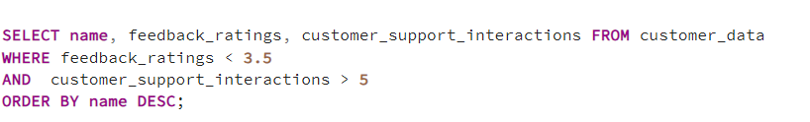
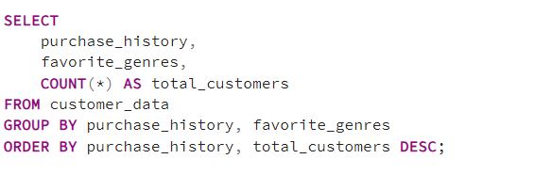
Problem 1: Identify if there is a pattern in customer purchase history (e.g., electronics, books, clothing) and their favorite genres (e.g., documentary, action, comedy).

Slide 4
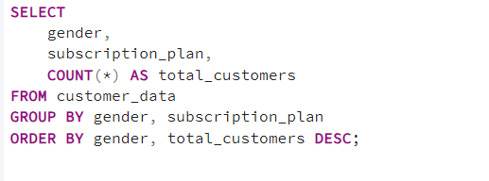
Problem 2: Determine which subscription plan (monthly vs. annual) is most popular among male and female customers. Are there any significant differences in the subscription choices based on gender?

Slide 5
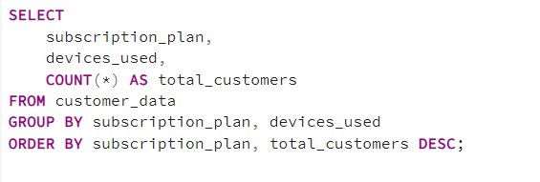
Problem 3: Evaluate which payment methods (Visa, Mastercard, Amex) are most commonly used by customers on monthly versus annual subscription plans. Is there any preference for specific payment methods based on subscription type?

Slide 6
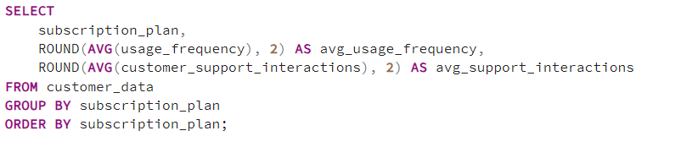
Problem 4: Analyze whether customer engagement (e.g., usage frequency, customer support interactions) differs between monthly and annual subscribers. Are annual subscribers more engaged compared to monthly subscribers?

Slide 7
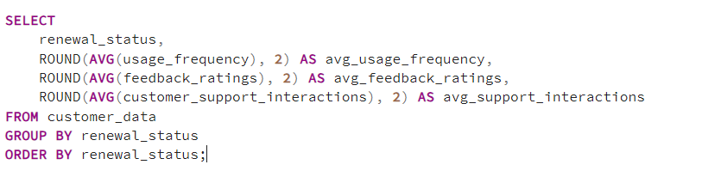
Problem 5: Examine whether customer engagement metrics (usage frequency, feedback ratings, customer support interactions) influence subscription renewal status. Are more engaged customers likely to renew their subscriptions?

Slide 8
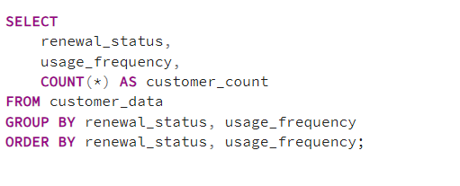
Problem 6: Analyze the relationship between customer engagement metrics (e.g., usage frequency, customer support interactions, feedback ratings) and subscription renewal status.

Slide 9
Problem 7: Identify the customers who have given feedback with a rating of less than 3.5 and have interacted with customer support more than 5 times.

Slide 10
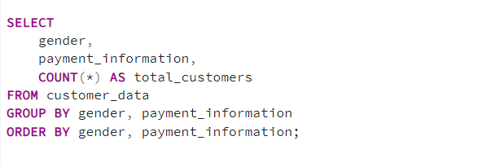
Problem 8: Determine if there is a significant difference in payment method preferences between male and female customers. Analyze the dataset to see which payment methods (Visa, Mastercard, Amex) are most used by each gender.

Slide 11
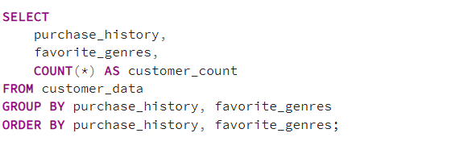
Problem 9: Investigate the relation between a customer's purchase history and their favourite genres. Does a particular genre align with specific purchasing behaviours?

Slide 12
Problem 10 : Evaluate which devices (e.g., smartphone, smart TV, tablet) are most commonly used by customers on different subscription plans.

Slide 13
Thank you

